Slide 1
Reading Skill 1
Main Idea

Slide 2
Finding the Main Idea of a Paragraph
Once you can find the topic, you are ready to find the main idea. The main idea is the point of the paragraph. It is the most important thought about the topic.
To figure out the main idea, ask yourself this question: What is being said about the person, thing, or idea (the topic)? Or What does the author want me to know about the topic?
The author can locate the main idea in different places within a paragraph. The main idea is usually a sentence, and it is usually the first sentence. The writer then uses the rest of the paragraph to support the main idea.

Slide 3
Example 1
First find the topic, then look for the main idea.
Summer is a wonderful time to spend at West Beach. It is a beach with light- colored, soft sand. The coastline goes on for a long way and many people enjoy walking along it. Children like to play in the surf and walk along the rocks that are visible at low tide. This is a fun beach for people of all ages.
Topic: West Beach
Main idea (what the writer is saying about the topic) is that summer is a wonderful time at West Beach

Slide 4
Example 2
First find the topic, then look for the main idea.
Most teenagers and young adults do not know what they want to do for the rest of their lives. It is a big decision. There are a number of things you can do to narrow the choices. For example you can take an interest test, do some research on your own about a career, try volunteer work in the field in which you are interested, or “job-shadow”, in which you spend a day with a person who is working in a field that interests you. These are just a few helpful ideas as you begin to choose a career.
Topic : Job or career choices
Main idea: There are a few helpful ways to choose a career

Slide 5
Example 3
First find the topic, then look for the main idea
The physical complaints of neurotics – people who are overly anxious, pessimistic, hostile, or tense – were once largely ignored by physician. Many doctors believed that the frequent complaint of neurotic were exaggerations. However, new research shows that neurotics are, in fact, more likely to have physical problems. Specifically, researchers found neurotics stand a greater chance of having five particular ailments: arthritis, asthma, ulcers, headaches, and heart disease. In addition, there is evidence that people who are pessimistic in their teens and twenties are more likely to become ill or die in their forties.
Topic: neurotics
Main idea: Neurotics are more likely to have physical problems.

Slide 6
Exercise 1
What is the main idea of this paragraph?
Being a clown isn't all fun and games. Rodeo clowns expose themselves to great danger every time they perform. When cowboys dismount or bulls buck them off, rodeo clowns jump in front of the bulls and motion wildly to get their attention. In this way rodeo clowns provide an alternate target, and in doing so protect the rider. Of course, this is a very dangerous thing to do. So you see, sometimes clowning around can be serious business.

Slide 7
Exercise 2
What is the main idea of this paragraph?
What's that humming sound? Could it be the hummingbird, the only bird capable of backward flight? Hummingbirds have many unique flight habits that distinguish them from other birds. Most birds flap their wings up and down to fly, but the hummingbird moves its wings forward and backward very rapidly in a figure eight pattern. This allows the hummingbird to hover in position. They can also fly upside down and move about very rapidly. Other birds have to push off with their feet to begin flying and work their ways up to their top speeds. The hummingbird can both start flying at maximum speed and stop flying instantaneously. Once you've seen a hummingbird in flight, it's unlikely that you'll mistake them for another bird.

Slide 8
Exercise 3
What is the main idea of this paragraph?
There are gender differences in adolescents' satisfaction with their bodies. Compared with boys, girls are usually less happy with their bodies and have more negative body images. Also, as puberty proceeds, girls often become even more dissatisfied with their bodies. This is probably because their body fat increases. In contrast, boys become more satisfied as they move through puberty, probably because their muscle mass increases.

Slide 9
Exercise 4
What is the main idea of this paragraph?
Remember, if something is worth doing, it is worth doing correctly. That said, the key to making perfect cookies is merely a matter of preparation and precision. To begin with, read your cookie recipe thoroughly before baking. Make sure that you have all the necessary ingredients before you continue. Next, use good tools and utensils. Sometimes, the craftsperson is only as good as his or her tools. By using good tools you minimize mistakes and improve the quality of your product. Last, use top quality ingredients. Unlike characters in fairytales, you can't turn lead into gold. If you use poor quality materials, you'll create inferior products. So, to make perfect cookies you should use the highest quality materials available. Bon appetite!

Slide 10
Main Idea of an Essay
The thesis statement is a one-sentence statement that expresses the main idea of the essay.
This idea controls the content of the essay.
The thesis statement is written at the end of the first paragraph (introduction).

Slide 11
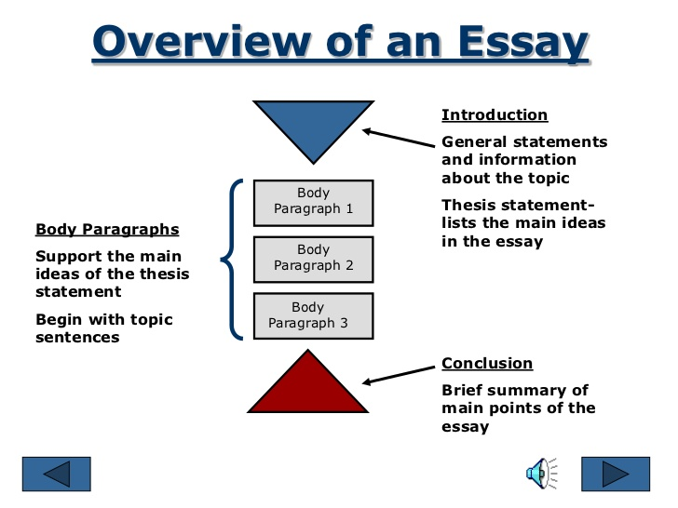

Slide 12
Essay Sample : Introduction
"A dog is man's best friend." That common saying may contain some truth, but dogs are not the only animal friend whose companionship people enjoy. For many people, a cat is their best friend. Despite what dog lovers may believe, cats make excellent housepets as they are good companions, they are civilized members of the household, and they are easy to care for.

Slide 14
Conclusion
Cats are low maintenance, civilized companions. People who have small living quarters or less time for pet care should appreciate these characteristics of cats. However, many people who have plenty of space and time still opt to have a cat because they love the cat personality. In many ways, cats are the ideal housepet.

